Slide 1
Unlicensed Driving

Slide 2
Overview:
Who are unlicensed drivers?
Crash risk of unlicensed drivers
Behaviours of unlicensed drivers
Legislation
Solutions

Slide 3
Who are unlicensed drivers?
Drivers who have a driver’s licence that is invalid because it is:
  suspended;
  revoked;
  inappropriate; or,
  expired or cancelled/denied.
Drivers who have do not undergo the process necessary to obtain a licence (Sweedler 2007).

Slide 4
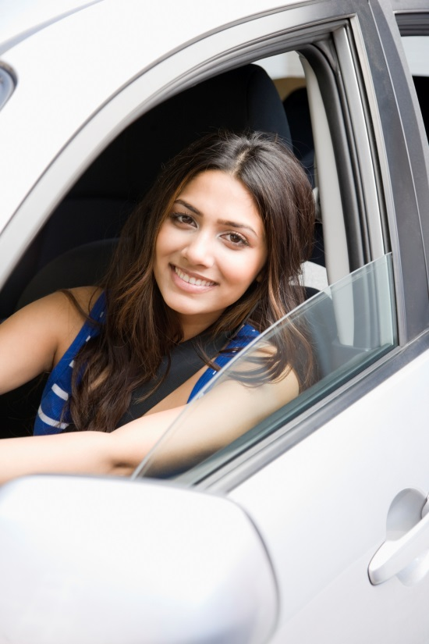
Why is a licence important to young drivers?
Driving represents freedom, mobility, and an increase in responsibility.
A licence is a tool that helps teens maintain an active lifestyle.

Slide 5
How many crashes involve unlicensed drivers?
In Ontario, about 2,000 fatal and serious-injury crashes occur every year involving unlicensed drivers.
  1 in 14 crashes involve an unlicensed driver (Sweedler 2007).
In the United States 1 in 5 fatal crashes involve unlicensed drivers (Scopatz et al. 2003).

Slide 6
What is the crash risk of an unlicensed driver?
Compared to licensed drivers, unlicensed drivers are:
  11 times more likely to be in a serious injury crash;
  2 times as likely to be at-fault in crashes (Blows et al. 2005).
Young, unlicensed drivers have a greater crash risk; 90% sustain an injury in a crash and almost half of them die (Hanna et al. 2006).

Slide 7
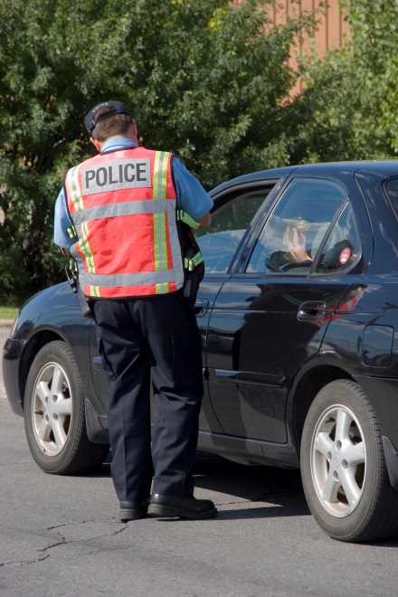
  What are the driving behaviours of unlicensed drivers?
Unlicensed drivers are more likely to:
  speed;
  drive drunk;
  run red lights;
  attempt to flee the scene of a crash;
  drive a motorcycle;
  not wear a seatbelt; and,
  not use a helmet (Sweedler 2007).

Slide 8
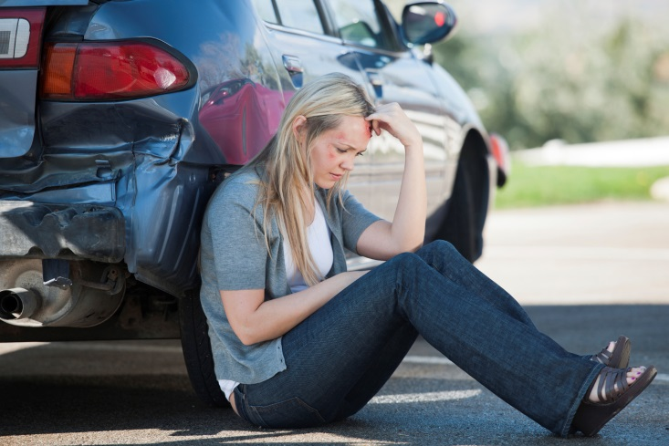
What are the driving behaviours of young unlicensed drivers?
Young unlicensed drivers are more likely to:
  drive without a specific purpose;
  have lower grades;
  live in rural areas or the central city; and,
  are less likely to have their father help them learn how to drive (Elliot et al. 2008).

Slide 9
  Who is most likely to drive unlicensed?
Unlicensed drivers are more likely to:
  be male (75%);
  live in economically deprived areas;
  drive an older vehicle;
  have limited supervised driving practice; and,
  provide family transportation before getting their licence (Hanna et al. 2006; Hanna et al. 2012).

Slide 10
  What are the crash characteristics of young unlicensed drivers?
Crashes involving young unlicensed drivers often occur:
  between Friday and Sunday;
  between 6 a.m. and 6 p.m.
  on high-speed roads, involving a single vehicle; and,
  with two or more occupants who are not wearing seat belts (Hanna et al. 2006).

Slide 11
  What will happen if a driver is caught driving unlicensed?
According to the Criminal Code of Canada, it is illegal for a person to operate a vehicle when they are not qualified to do so.
Consequences include:
  vehicle impoundment;
  fines; and,
  jail time.

Slide 12
  What can the government and law enforcement do to reduce unlicensed driving?
Increased law enforcement and stricter penalties targeting unlicensed drivers have been shown to reduce overall crash rates.
Proven penalties include:
  confiscating vehicle registration or licence plates and,
  vehicle impoundment or seizure.

Slide 13
  What can drivers do to reduce unlicensed driving?
Young drivers should follow the restrictions of graduated driver licensing (GDL) programs.
They should carry vehicle insurance that meets provincial requirements.
Driver licenses should be kept up to date and renewed, including licence plate stickers.

Slide 14
For more information, visit us at:
www.yndrc.ca
www.tirf.ca
Stay informed!

