Slide 1
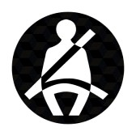
SEATBELTS

Slide 2
Overview: seatbelts
What are seatbelts?
Seatbelt use in Canada
Myths and misconceptions about seatbelts
Solutions

Slide 3
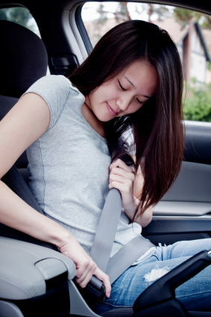
What are seatbelts?
  Mandatory safety feature provided for each seat in the vehicle.
  Secures passengers by crossing their chest/waist with a material belt that fastens into the side of the seat.
  Other safety features such as airbags and head restraints are more effective if the occupant is wearing their seatbelt.

Slide 4
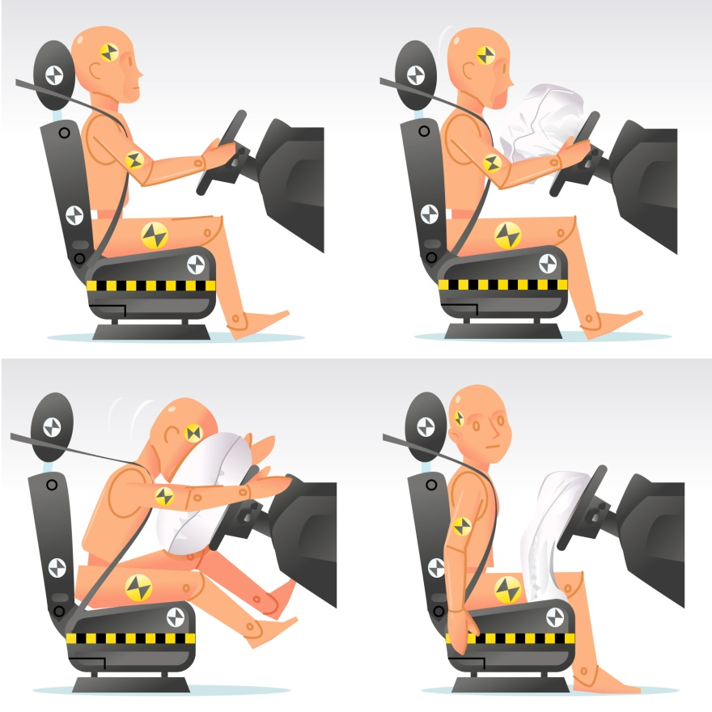
Importance of seatbelts
Seatbelts reduce risk of serious injury to the head, chest and extremities by 50%-83%.
Even with more sophisticated safety features, seatbelts are still considered the most important.

Slide 5
Importance of seatbelts
Seatbelts reduce the movement of occupants inside the vehicle during a crash.
  Body’s contact with other objects in the vehicle (steering wheel, dashboard) is minimized.
  Prevents passengers from becoming projectiles in a crash and potentially killing other occupants.
Prevents occupants from being thrown out of the vehicle.
  3/4 of occupants ejected from a vehicle will die.

Slide 6
Seatbelt use in Canada
Seatbelt use in Canada increased from 93% in 2007 to 95% in 2010.
In 2007, the 7% of Canadians that did not wear seatbelts accounted for almost two-fifths (40%) of collision fatalities.
Seatbelts save a thousand lives a year in Canada*.
Increasing seatbelt usage to 100% would save a significant number of lives.
*Data from Transport Canada 2010

Slide 7
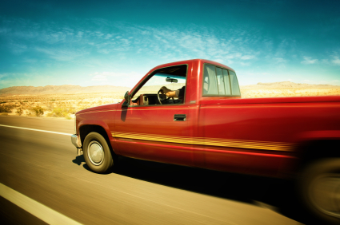
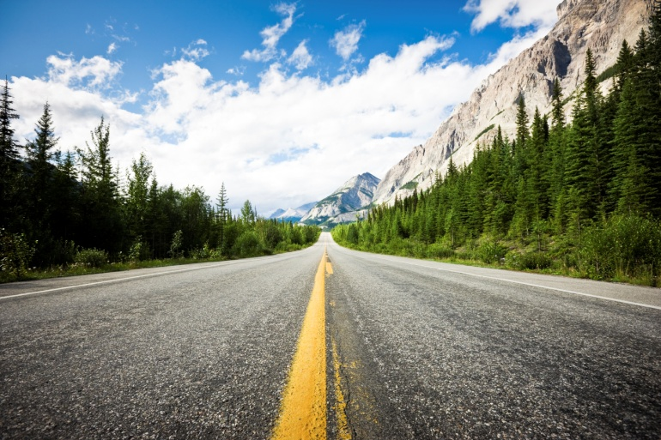
Occupants who don’t use seatbelts
  Males;
  Drivers aged 19-24;
  Those who live in rural areas;
  Occupants of pick-up trucks;
  Risky drivers; and,
  Occupants who have consumed alcohol.
Notes:
Risky drivers are drivers who are more likely to drive dangerously: follow too close to other vehicles, run red lights or speed.

Slide 8
Low rate of seatbelt use
Young drivers are less likely to wear seatbelts when:
  driving late at night;
  with passengers who have been drinking; and,
  with passengers under the age of 29.
Young passengers have a lower rate of seatbelt use than young drivers:
  Seatbelt use is much lower among back seat occupants (89%) than front seat occupants (96%)*.
  *Data from Transport Canada 2010
Notes:
At all ages, belt use is lower in situations with higher crash risk.

Slide 9
Prevalence of belt use among crash victims
In Canada between 2006 and 2010, the percentage of drivers who were fatally injured in a crash ranged from 33.6% to 36.9%
In serious injury crashes, more passengers were found to be without a seatbelt compared to drivers (20.5%-24.8% between 2006-2010 compared to 12.9%-16.2% respectively).
*Data from Transport Canada 2010
Notes:
At all ages, belt use is lower in situations with higher crash risk.

Slide 10
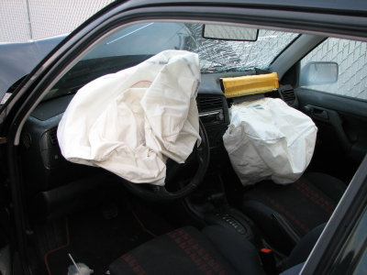
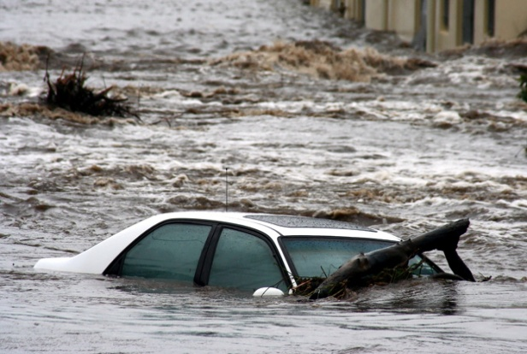
Myths about seatbelts
  Myth: When there are airbags, you don’t need seatbelts.
  Fact: Airbags, without wearing seatbelts, can kill*.
  Myth: Seatbelts prevent passengers from escaping burning vehicles and vehicles submerged in water.
  Fact: Seatbelts prevent occupants from being knocked unconscious, increasing the chance of escaping by three to five times.
Notes:
*Many safety features only work when used in combination with seatbelts. Air bags deploy at a high rate of speed. Wearing a seatbelt is important to ensure the air bag protects the passenger.

Slide 11
Myths about seatbelts
  Myth: Seatbelts are unnecessary for short trips at low speeds.
  Fact: 70% of road crashes where the occupants are unrestrained occur at speeds under 50 km/h and 2/3 of crashes happen less than 15 km/h from home.
  Myth: It’s safer to be thrown out of a vehicle in a crash.
  Fact: An occupant is four times more likely to die if thrown from a vehicle in a crash.

Slide 12
Teen thoughts on seatbelts
Although teens know that driving without a seatbelt is a hazardous behaviour, many only wear seatbelts because:
  it’s something parents insist on.
  they may get stopped by police and get a hefty fine.
  the weather is bad or they are with a dangerous driver.
Regardless of the opinions of young drivers, seatbelts should be worn at all times: occupants that don’t wear a belt are putting others at risk for injury and/or death.

Slide 13
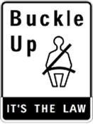
Legislation
All provincial Highway Traffic Acts have laws regarding the proper use of seatbelts:
  All seatbelts must be working.
  All occupants must be wearing a seatbelt.
  If passengers are under the age of 16 it is the responsibility of the driver that they have a functioning seatbelt and are wearing it properly.

Slide 14
Solutions
In order for seatbelts to reduce the risk of death or injury in a collision up to 60%, they must be worn properly:
  Buckle belt securely;
  Fit lap belt snugly across hips, not abdomen;
  Ensure belt sits firmly across the chest, never tucked under the arm;
  Do not recline the seat while wearing a seatbelt in a moving vehicle; and,
  Allow only one passenger per belt.

Slide 15
Seatbelt initiatives
The rollover simulator:
  Shows the difference between a crash while wearing a seatbelt and a crash without wearing a seatbelt.
  A motor rolls a cab of a vehicle simulating a rollover incident, with straw-filled dummies.
Click it or ticket:
  Raised awareness about the fines for not wearing a seatbelt.
  Television commercials, posters, and other public advertisements made the program a success.
Notes:
The rollover simulator tours around Canada with the RCMP to show individuals the importance of wearing a seatbelt.
Due to the Click It or Ticket Program, seatbelt use by 16-24 year olds increased from 61% in 1996 to 82% by 2003 in areas of the United States.

Slide 16
For more information:
www.yndrc.tirf.ca
SGI - Rollover Simulator
NHTSA - Click It or Ticket
Sussex Safer Road – Embrace Life – YouTube

Slide 17
Quiz: true or false?
All provincial Highway Traffic Acts state that all occupants must be wearing working seatbelts.
Other vehicle safety features are less effective if the occupant is wearing a seatbelt.
Notes:
True
False: Other vehicle safety features are MORE effective if the occupant is wearing a seatbelt.

Slide 18
Quiz: multiple choice
Occupants who don’t use seatbelts are commonly:
  Male
  Aged 19-24
  Have consumed alcohol
  All of the above
Notes:
Answer: D

Slide 19
Discussion
If passengers in your car aren’t wearing their seatbelts, what would you say or do?

