Slide 1
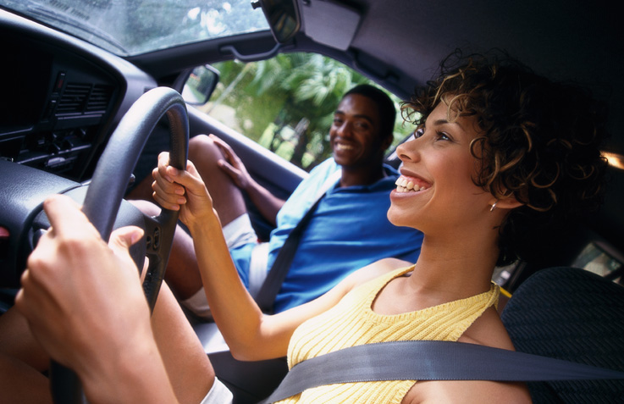
Passengers

Slide 2
Overview:
What are the issues?
Behaviours of passengers
Attitudes and concerns
Legislation
Solutions

Slide 3
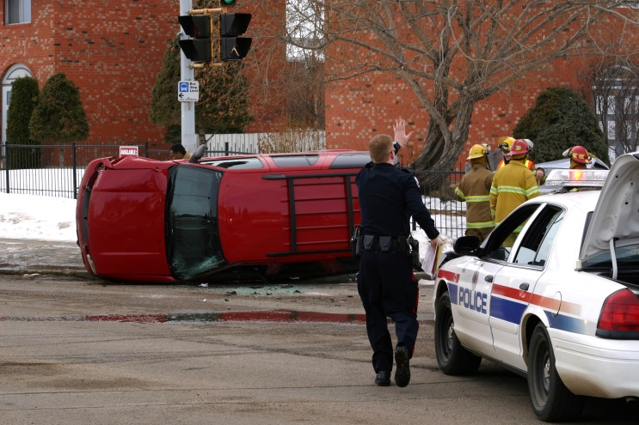
Do young passengers increase young driver crash risk?
Yes, passengers directly affect the crash risk of young drivers.
Crash risk increases incrementally with one, two, three or more passengers by three to five times (Williams et al. 2002).
Death rates of 16-19 year old passengers are higher than any other age group.

Slide 4

Do all passengers increase crash risk for young drivers?
Passengers under age 12 or older than 25 years have a protective effect on young drivers, and lower their crash rate (Williams et al. 2007).
Young male passengers pose the greatest risk to young drivers.

Slide 5
How do passengers increase the crash risk of young drivers?
Young passengers can:
  distract drivers by talking to them or turning up the music;
  encourage drivers to take risks; or,
  interfere physically with the operation of the vehicle.
The presence of teen passengers can encourage young drivers to show off through peer influence.
Young passengers of the opposite sex have a particularly distracting effect on drivers.

Slide 6

When do passengers increase crash risk?
Overall crash risk is highest at night.
Young drivers are more likely to have been drinking when there are three or more passengers in the vehicle (National Safety Council 2007).

Slide 7
How many passengers die due to alcohol-related young driver crashes?
Riding with an impaired driver is common behaviour among young people (Marcoux et al. 2010).
23% of high school students reported that they would ride with an impaired driver (Calafat et al. 2009).
University students are even more likely to accept a ride from a driver who has been drinking (Calafat et al. 2009).

Slide 8
Who is most likely to ride with a young impaired driver?
Riding with an impaired driver is common among youth that:
  live in rural areas;
  have either a single parent or no parents;
  have a lower income; and,
  lower levels of education.
Males and females have similar rates of riding with an impaired drivers (Calafat et al. 2009).
People who drive impaired are more likely to ride with an impaired driver

Slide 9

What do young drivers think about young passengers?
Almost half of American teenage drivers believe that having young peers in the car is distracting;
44% of students felt that they were safer drivers without their friends in the vehicle (Williams et al. 2007).

Slide 10
Are there specific laws for young drivers about passengers?
All provinces and most territories have GDL programs that that also include passenger restrictions for young drivers at various stages of the program.

Slide 11
How can we reduce the crash risk of young drivers with passengers?
Extend passenger restrictions to all times of the day during GDL stages.
  GDL programs have been found to reduce 30% of passenger injuries and deaths (Chaudhary 2007).
Parental involvement is important throughout the licensing process.

Slide 12
What programs are available which support passenger restrictions?
The Speak Out program was created by the Norwegian Public Roads Administration in 1983.
It encourages teen passengers to speak out if the driver they are with is driving dangerously.
The Transport Accident Commission in Melbourne, Australia developed the “If you don’t trust the driver, don’t get in” campaign in 1997.

Slide 13
For more information, visit us at:
www.yndrc.ca
www.tirf.ca
Stay informed!

