Slide 1
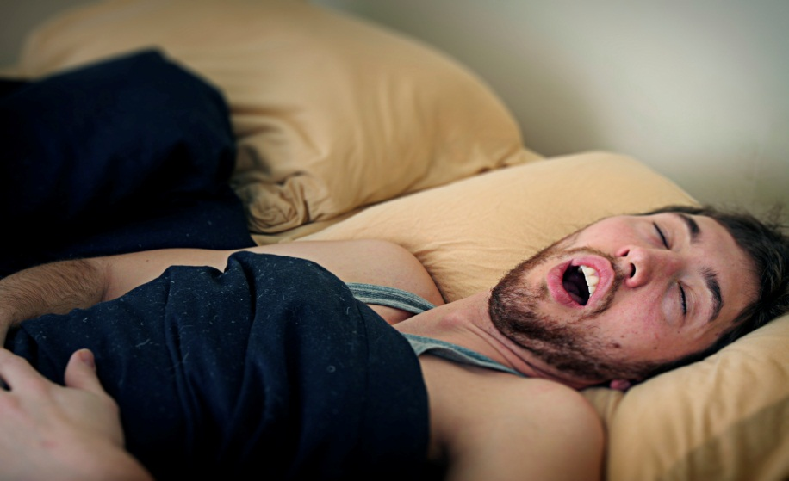
FATIGUED DRIVING

Slide 2
Overview
What is fatigue? What is drowsiness?
What are the characteristics of fatigued-driving?
What are the characteristics of fatigued drivers?
Attitudes
Legislation
Solutions

Slide 3
What is drowsiness vs. fatigue?
Drowsiness (sleepiness):
  Caused by body’s biological rhythm.
  Happens twice a day: afternoon and night.
  Teenagers need at least 9 hours of sleep.
  There is no cure for drowsiness besides sleep.
Fatigue:
  Weariness, lack of desire to continue driving.
  Can be caused by repetitiveness of the driving task.
  Occurs after extended periods without rest or break.
Notes:
Both terms can be used interchangeably because they have the same consequences for driving.

Slide 4
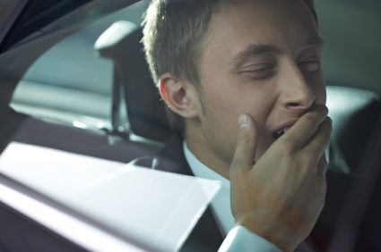
Signs of fatigue
  Yawning;
  Tired eyes;
  Heavy eyelids;
  Hard to keep still;
  Can’t concentrate;
  Inability to predict falling asleep;
  Nodding off.

Slide 5
How common is fatigued driving?
In the 2011 Road Safety Monitor (RSM), almost one fifth (18.5%) of Canadians reported nodding off or falling asleep at the wheel in the past year.
In Ontario, it is estimated just over one-quarter (26%) of all fatal and injury crashes are due to fatigue*.
In the United States, between 79,000 and 103,000 crashes a year are caused by fatigue, with 71,000 injuries and 1,500 fatalities**.
*Data from Elzohairy 2007 and **NHTSA

Slide 6
How does fatigue affect driving?
Driver is no longer paying full attention to the driving task.
Driver can no longer perform important driving tasks (e.g., staying in lane).
Driver will experience a decrease in reaction time, coordination, and decision making (all skills needed to drive safely).
Driver may experience irritability.

Slide 7

Teen risk for fatigue
Teens are one of the groups most at risk: 28% of 16 to 19 year olds report nodding off while driving*.
Teen lifestyle (part-time jobs, after school sports or clubs, homework, socializing) does not leave enough time for sleep.
*Data from the 2004
Road Safety Monitor

Slide 8
Circadian rhythm
The human body has a circadian rhythm (body’s clock) that make the body sleepy at night and in the afternoon.
Biological changes at puberty:
  Circadian clock makes it difficult for teenagers to fall asleep.
  Teens also have decreased alertness during the day.
Approximately the same percentage of people report falling asleep during the time periods of 12 pm-5 pm and 12 am-6 am*.
*(Tefft 2010)
Notes:
Teens develop limit-testing behaviours (e.g., risky driving).
These factors combined with teen’s incredibly busy lifestyle put teens at a high risk for fatigue.

Slide 9
Dangers of fatigued driving
People are not good at judging how likely it is they will fall asleep.
Some drivers do not recognize or admit to feeling sleepy before a fatigue-related crash.
Once a driver is drowsy it is difficult to overcome this feeling (only sleep will cure it).

Slide 10
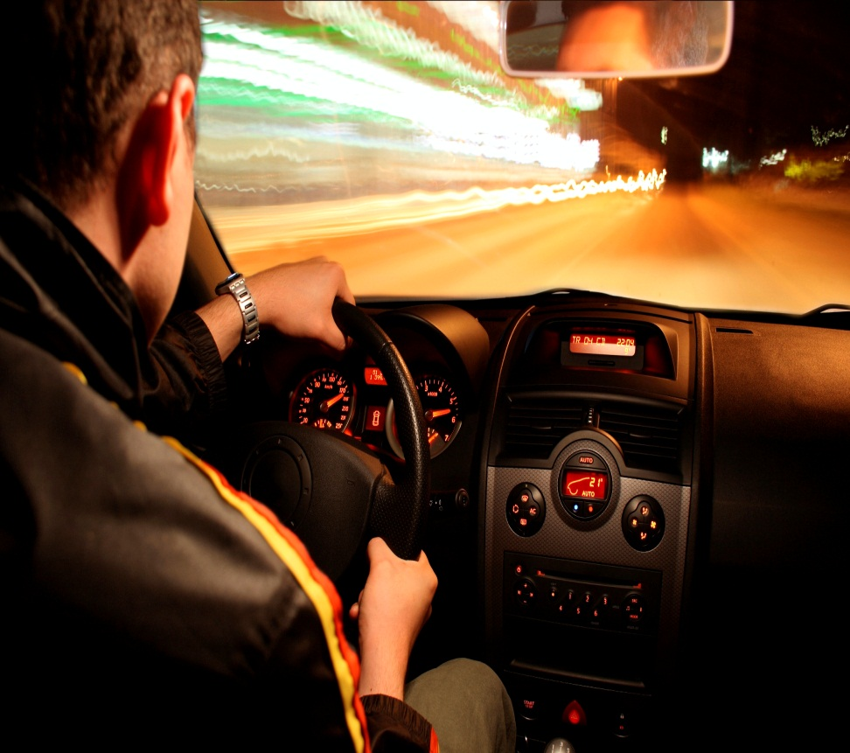
Characteristics of a fatigue-related crash
  Driver is alone;
  Driver is young and male;
  Single vehicle, run off roadway;
  Higher speed highways;
  Result in serious injury; and,
  Occur between 3 pm–6pm and 12 am–7 am.
Notes:
Collision are often head on, or rear-end
often no brake marks

Slide 11


Fatigue and alcohol:
Fatigue has similar effects to alcohol intoxication:
  A person who has not had proper rest in 17 hours = a person with a blood alcohol concentration of 0.05 (legal limit is 0.08).
Fatigue heightens the effects of alcohol, even small amounts (1 or 2 drinks).

Slide 12
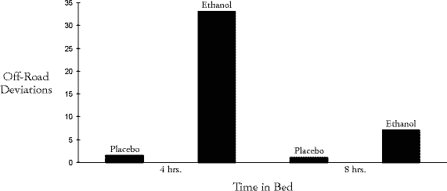
How does alcohol affect fatigued driving?
With less sleep, alcohol has been shown to be associated with many more “off-road deviations” indicating that alcohol does compound the effects of fatigue*.
*Roehrs et al. 1994

Slide 13
Young driver attitudes
When surveyed, young drivers reported they were not afraid of getting caught or getting into a crash when driving while fatigued.
Young drivers acknowledged the dangers of fatigued-driving but were not willing to stay off the roads if they felt fatigued and needed to drive.

Slide 14
Legislation
Police can use a variety of actions to deal with a fatigued driver:
  Give the driver a warning;
  Arrange for alternate transportation;
  Charge the driver with a provincial offence (e.g., unsafe lane change);
  Charge the driver with a criminal offence (e.g., careless driving); or,
  Make an arrest.

Slide 15
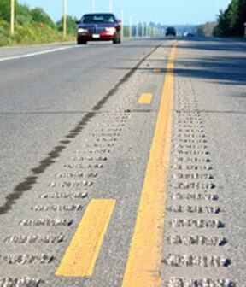
Solutions: reducing fatigue
Highway infrastructure:
  Rumble strips, rest areas, proper maintenance.
Technology:
  Driver monitoring system alerts the driver if it detects drowsiness.
  If a vehicle loses lane position the system alerts the driver with a light and alarm.

Slide 16
Solutions: reducing fatigue
Make sure to get the proper amount of sleep before a trip.
Plan ahead to have adequate sleep leading up to the trip. (e.g., if you are aware you have a long drive Sunday morning, do not stay up late Friday and Saturday night).
Take a break every 2-3 hours.

Slide 17

Solutions: reducing fatigue
Naps and caffeine will ultimately not help and can lead to the body “crashing” (getting tired again suddenly and severely); only sleep will cure fatigue.

Slide 18
For more information:
www.yndrc.tirf.ca
www.tirf.ca
The Facts About Fatigued Driving in Ontario – A Guidebook for Police

Slide 19
Quiz: true or false?
Fatigue heightens the effects of alcohol, but only large amounts.
People are not good at judging how likely it is they will fall asleep.
Notes:
False. Fatigue heightens the effects of alcohol. Even SMALL AMOUNTS.
True.

Slide 20
Quiz: multiple choice
The human body has a circadian rhythm that make the body sleepy at night and:
  In the morning.
  On the weekend.
  While you’re eating.
  In the afternoon.
Notes:
Answer: D

Slide 21
Discussion
How do you feel when you have not had enough rest?
Would you leave your car at school or at a friend’s house if you knew you hadn’t slept enough the night before?

